Slide 1
Risk Analysis & HAZID
TDI-Brooks International
Nov 2015

Slide 2

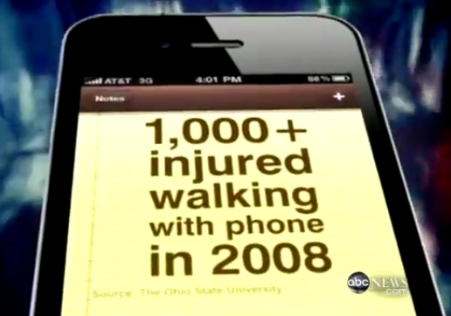
Situational Awareness
You are exposed to dangers every day– but do you recognize them?

Slide 3
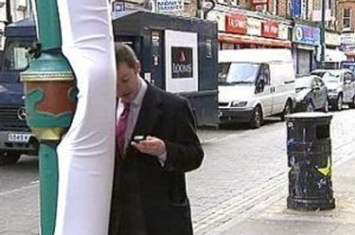
Situational Awareness
So many people get injured because they are not paying attention to where they walk that cities have had to “idiot proof” common obstacles.

Slide 4
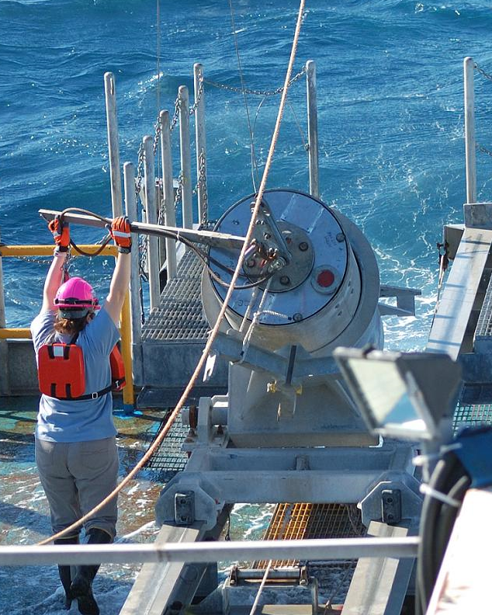
Situational Awareness
You work offshore on a moving vessel in all types of weather.
How much more dangerous is your job?

Slide 5
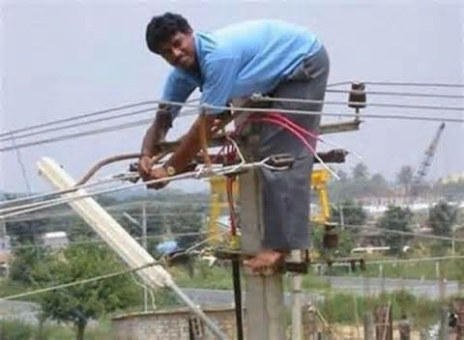
Analyze the Risk
Before beginning any task, you need to STOP and analyze the risks.

Slide 6
Hazard or Risk?
Hazard is any potential for harm (to yourself, environment or equipment)
Risk = Hazard + Exposure
If there is no exposure, then there is no risk.

Slide 7
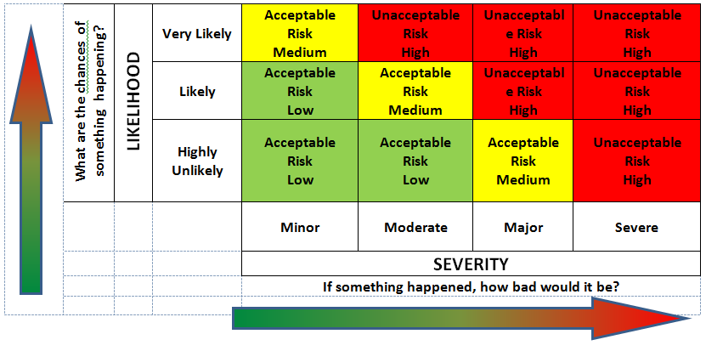
Likelihood vs. Severity
Risks are rated by likelihood (probability) and severity of the potential consequences.

Slide 8
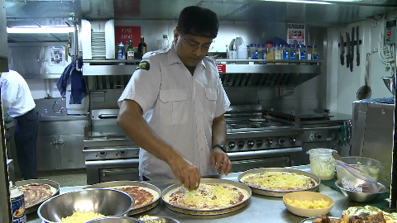
Analyzing Risk
The ship’s cook is exposed to heat & steam every day as part of his job.

Slide 9
Analyzing Risk
The process of cooking anything will involve the production of steam and heat. (hazards)
The cook has to be near the steam and heat to prepare the food. (exposure)
Hazard is mitigated by using oven gloves.

Slide 10
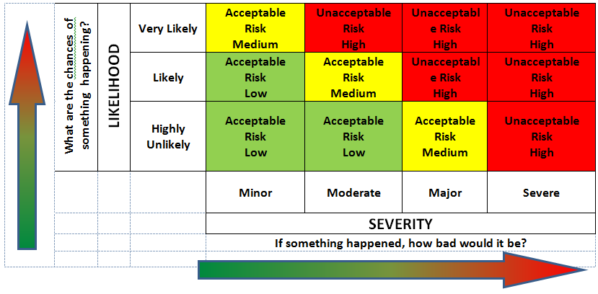
Heat & Steam Exposure
Frequent exposure to heat and steam at low levels and with mitigations (oven gloves) is acceptable.

Slide 11
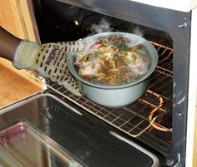
Heat & Steam Exposure
Very Likely + Low severity + Mitigations= Acceptable risk

Slide 12
Analyzing Risk
The radiator of a car also contains heat and steam. (hazard)
But that heat and steam is under pressure and contained in the radiator. (no exposure)
Hazard - Exposure = No Risk

Slide 13
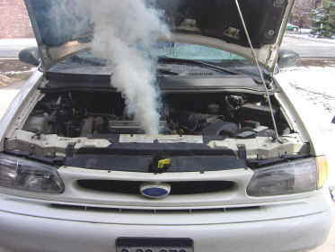
But what will happen if you try to open a hot radiator?
Exposure to a severe hazard

Slide 14
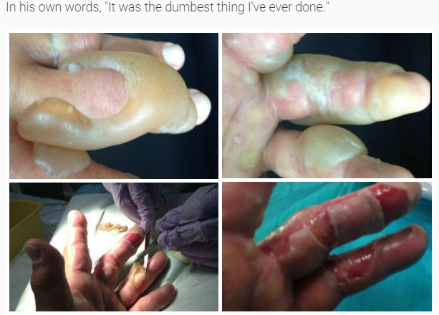
This man tried to hit the radiator release valve on a hot engine with his bare hands.

Slide 15
Heat & Steam Exposure
A single exposure to pressurized heat and steam from a hot radiator is very harmful. Unacceptable risk

Slide 16
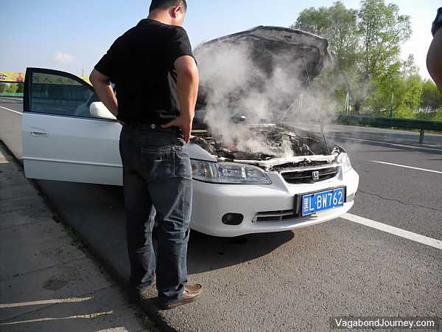
To lower to acceptable risk, use mitigations
Mitigations-
Wait until radiator cools
Use heat protective gloves when opening

Slide 17
Radiation Exposure
Daily exposure (likely) to high level radiation is very harmful. (major)
Welders are exposed to high levels of hazardous UV light produced by electric arcs every time they work.

Slide 18
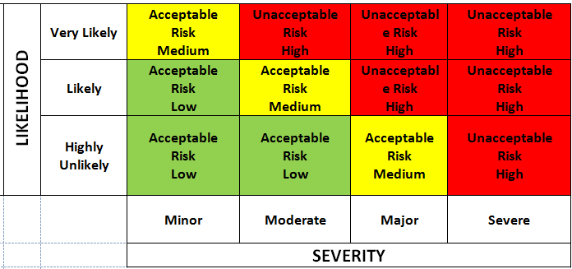
Radiation Exposure
Very Likely + Severe =
Unacceptable risk

Slide 19
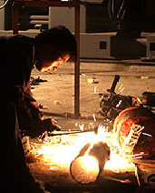
Radiation Exposure
Extreme risk is unacceptable.
The risk must be reduced to an acceptable level

Slide 20
How to Reduce the Risk?
To reduce risk, you have to reduce the probability or the severity.
A welder must be exposed to the hazard of UV radiation in order to work.
Removing the exposure is not an option.

Slide 21
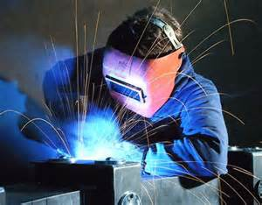
How to Reduce the Risk?
Reducing the exposure is an option
A welding hood significantly reduces the amount of UV radiation that reaches the eyes.

Slide 22
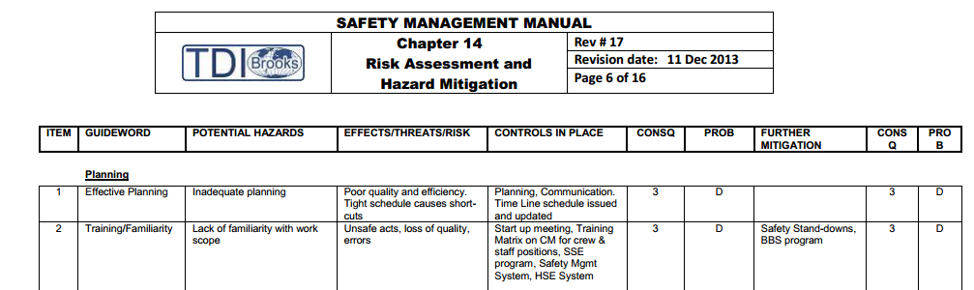
Hazard Identification (HAZID)
Before starting a job, TDI-Brooks works with the client to develop a Hazard Identification or HAZID.
A sample HAZID is in the SMM Chapter 14.

Slide 23
What a HAZID Analyzes
The standard HAZID reviews all the potential risks associated with planning and executing the project.
The HAZID is a review of the BIG PICTURE– or the project as a whole.

Slide 24
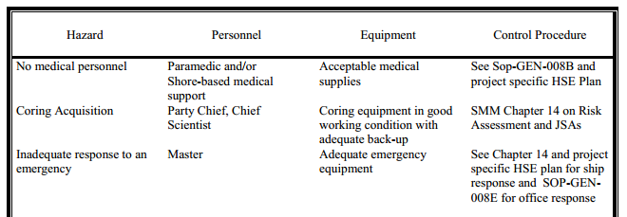
What a HAZID Analyzes
It also lists mitigations for every hazard from travelling to the boat, to how samples are collected, required PPE and what to do in case of an oil spill or MEDEVAC.

Slide 25
Job Safety Analysis (JSA)
Risk for specific tasks are assessed in the form of a Job Safety Analysis or JSA.
It is a smaller version of the HAZID:
  JSA lists the steps to complete the task
  JSA lists the risks related to each step
  JSA lists the PPE, procedures and other mitigations to minimize those risks

Slide 26
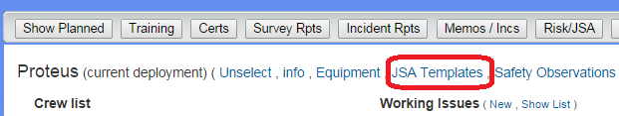
JSAs on Crewing Module
Templates for survey and coring activities JSAs are on the Crewing Module just under the boat name.

Slide 27
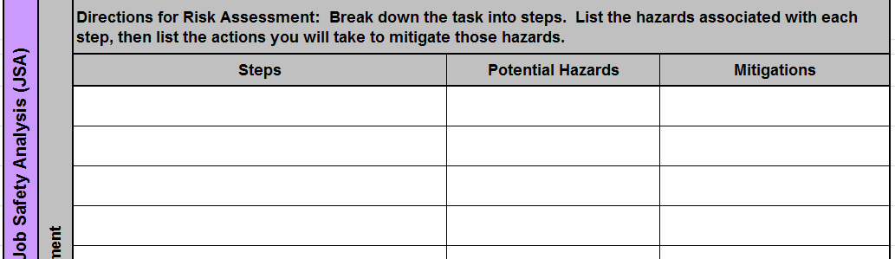
JSAs in Permit Work
For any work requiring a permit, the JSA is integrated into the permit.

Slide 28
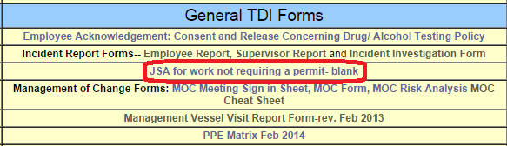
JSAs For Non Permit Work
For work that does not require a permit, there is a blank JSA template on the ship web pages.

Slide 29
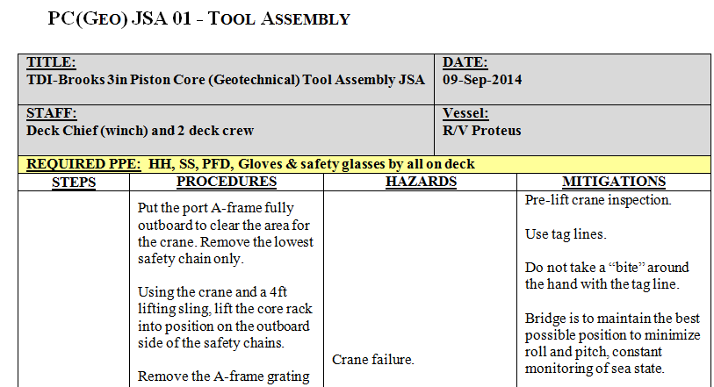

Review JSAs Every Time
Review the JSA every time before you do that task. Situations or conditions may have changed.

Slide 30

STOP WORK Authority
ANY employee, regardless of position or experience with the company, is empowered, encouraged and expected to STOP WORK if he feels anything is unsafe, or if he is unsure of his role/ responsibilities regarding an operation.

Slide 31
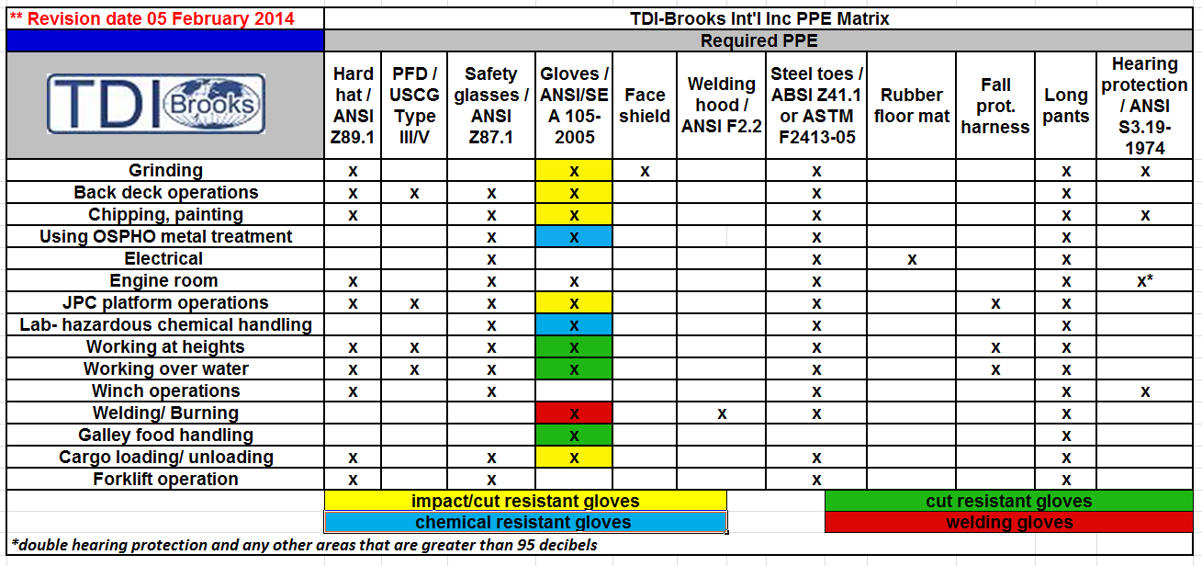
PPE Matrix
The PPE matrix tells you what PPE is required for common tasks.

Slide 32
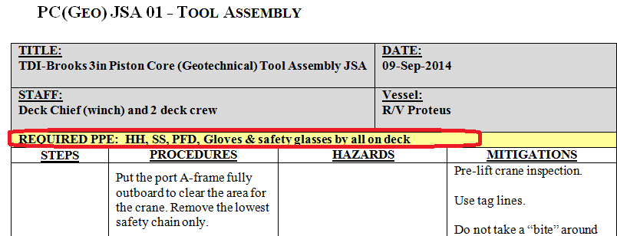
PPE
The JSA team will determine what is needed for a specific task.

Slide 33
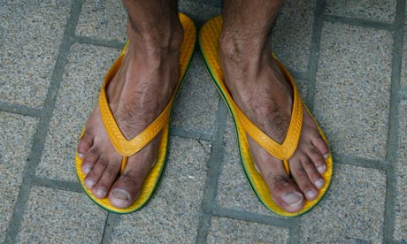
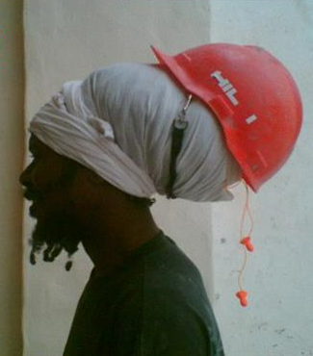
STOP WORK Situations
Someone not wearing correct PPE or not wearing it correctly? STOP WORK

Slide 34
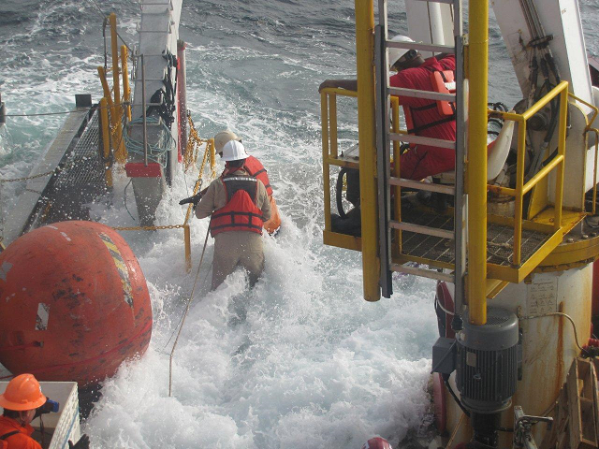
STOP WORK Situations
Someone putting themselves at obvious risk? STOP WORK

Slide 35
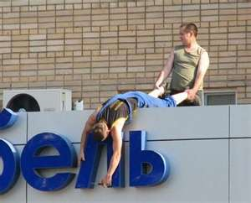
STOP WORK Situations
Someone not following procedures?
STOP WORK

Slide 36
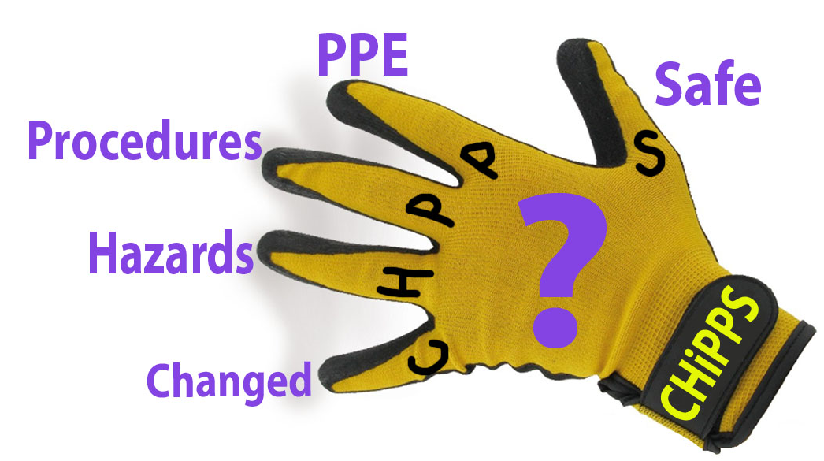
Last Minute Risk Assessment
TDI has a Last Minute Risk Assessment (LMRA)
Just before you begin to work, ask yourself these 5 questions:

Slide 37
Has anything CHANGED?
What HAZARDS will I face?
Am I following PROCEDURES?
Wearing proper PPE?
How will I stay safe?

Slide 38
Questions?
???

